Slide 1
HOL in Vmware

Slide 2
Type 2 Hypervisor
Type 2 Hypervisor is called a Host OS Hypervisor. These hypervisors execute on an operating system similar to other computer programs. For example, assume that there is an operating system. There is a hypervisor on top of the OS. It provides an emulator environment to run another operating system. Eg Vmware Workstation Pro.

Slide 3
Type 1 hypervisor
Type 1 hypervisor is a hypervisor that runs directly on the host’s hardware to control the hardware and to manage guest operating systems. Example Vmware ESXi.
Now we will work on type 1 hypervisor through “Hands on lab”.

Slide 4
Hands on lab
Hands-on Labs are the fastest and easiest way to test-drive the full technical capabilities of VMware products. These evaluations are free, up and running on your browser in minutes, and require no installation.
This introductory lab demonstrates the core features and functions of vSphere and vCenter. This is an excellent place to begin your experience with VMware vSphere

Slide 5
vSphere
vSphere is a software suite that comes under data center product. vSphere is like Microsoft Office suite which has many softwares like MS Office, MS Excel, MS Access and so on. Like Microsoft Office, vSphere is also a software suite that has many software components like vCenter, ESXi, vSphere client and so on.
So, the combination of all these software components is vSphere. vSphere is not a particular software that you can install and use, “it is just a package name which has other sub components”.
ESXi, vSphere client and vCenter are components of VMware vSphere. ESXi server is the most important part of vSphere. ESXi is the virtualization server. It is type 1 hypervisor. All the virtual machines or Guest OS are installed on ESXi server.

Slide 6
EXSI
ESXi is a hypervisor, or a type of virtualization software that allows you to create and manage multiple virtual machines using a single physical host. ESXi is installed directly on a physical machine, meaning that it is a bare-metal hypervisor.

Slide 7
vCentre
VMware vCenter Server allows for centralized management of your virtual infrastructure. You can control your hosts and VMs from a single console, which enhances visibility and helps with error prevention.
Notes:
vCenter 7 Overview vCenter Server unifies resources from individual hosts so that those resources can be shared among virtual machines in the entire datacenter. It accomplishes this by managing the assignment of virtual machines to the hosts and the assignment of resources to the virtual machines within a given host based on the policies that the system administrator sets.
VMware vCenter Server is advanced server management software that provides a centralized platform for controlling your VMware vSphere environments, allowing you to automate and deliver a virtual infrastructure
Where does vCenter Server run?
You can install vCenter Server in a Microsoft Windows virtual machine that runs on an ESXi/ESX host.

Slide 8
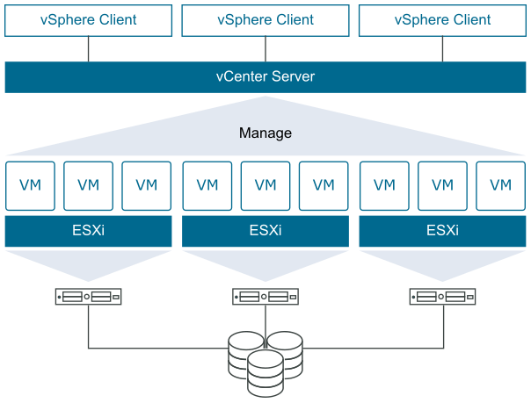
Complete Vsphere
Notes:
Storage then host
Esxi is installed on host .

Slide 9
VsphereClient
Use the vSphere Client to connect to vCenter Server systems and manage vSphere inventory objects.
Use of the vSphere Client requires a supported Web browser.
The home screen of the vSphere Client is a system dashboard that aggregates data from different sources in the environment together in a single, unified view.
Notes:
The other component is the vSphere Web Client. The vSphere Web Client is the interface to vCenter Server and multi-host environments. It also provides console access to virtual machines. The vSphere Web Client lets you perform all administrative tasks by using an in-browser interface.
vSphere Client which is used to connect to vCenter Server to manage your collective infrastructure as a whole. In addition, the process of creating a virtual machine will also be covered. The vSphere Client is the primary method for system administrators and end-users to interact with the virtual data center environment created by VMware vSphere. vSphere manages a collection of objects that make up the virtual data center, including hosts, clusters, virtual machines, data storage, and networking resources. The vSphere Client is a Web browser-based application that you can use to manage, monitor, and administer the objects that make up your virtualized data center. You can use the vSphere Client to observe and modify the vSphere environment in the following ways. •Viewing health, status, and performance information on vSphere objects •Issuing management and administration commands to vSphere objects •Creating, configuring, provisioning, or deleting vSphere objects

Slide 10
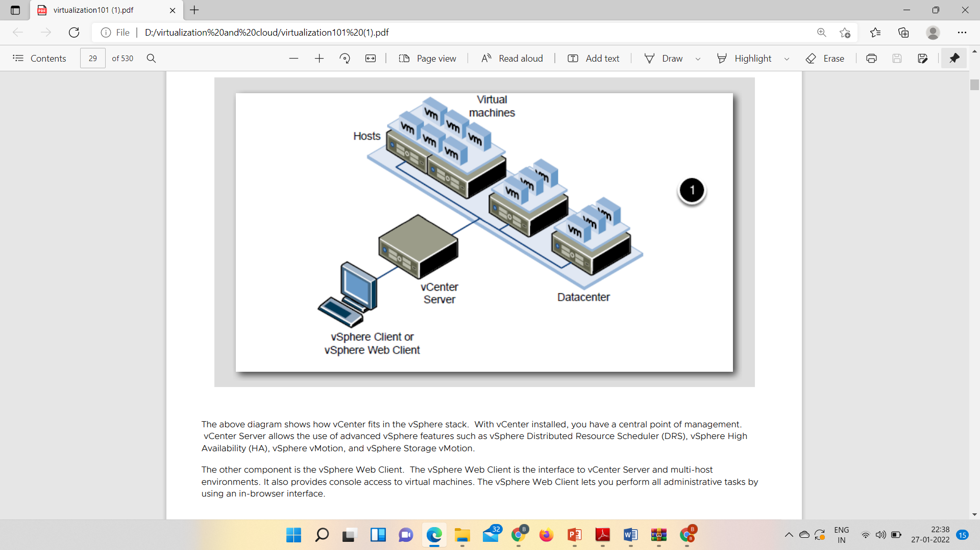

Slide 11
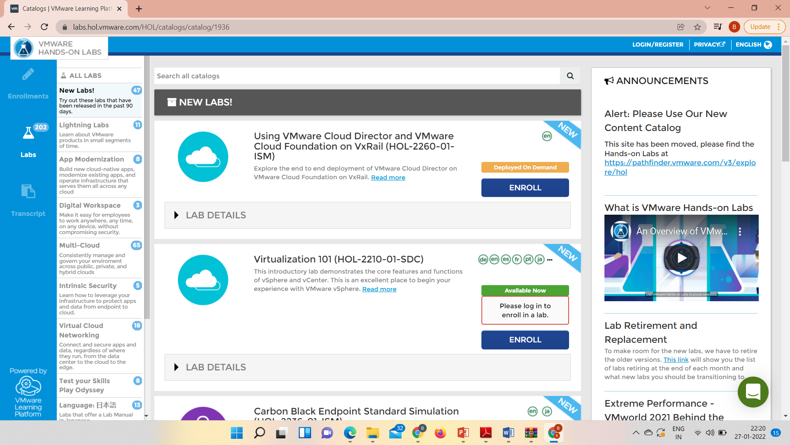

Slide 12
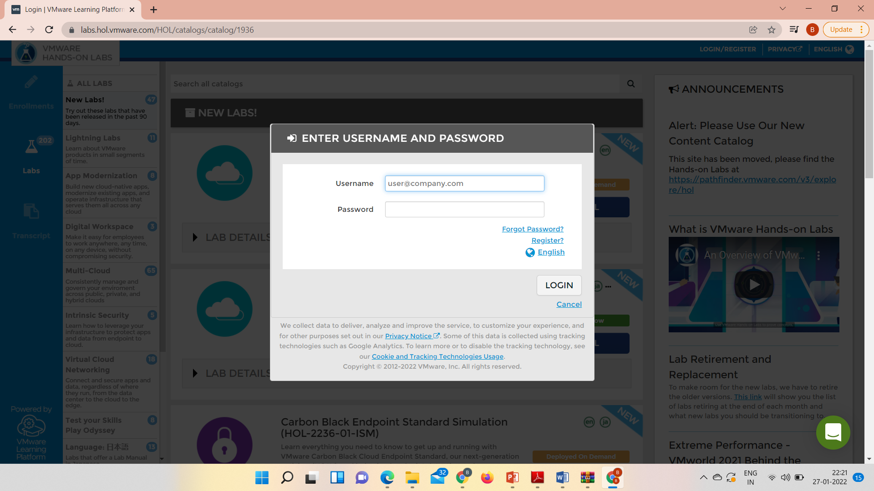

Slide 13
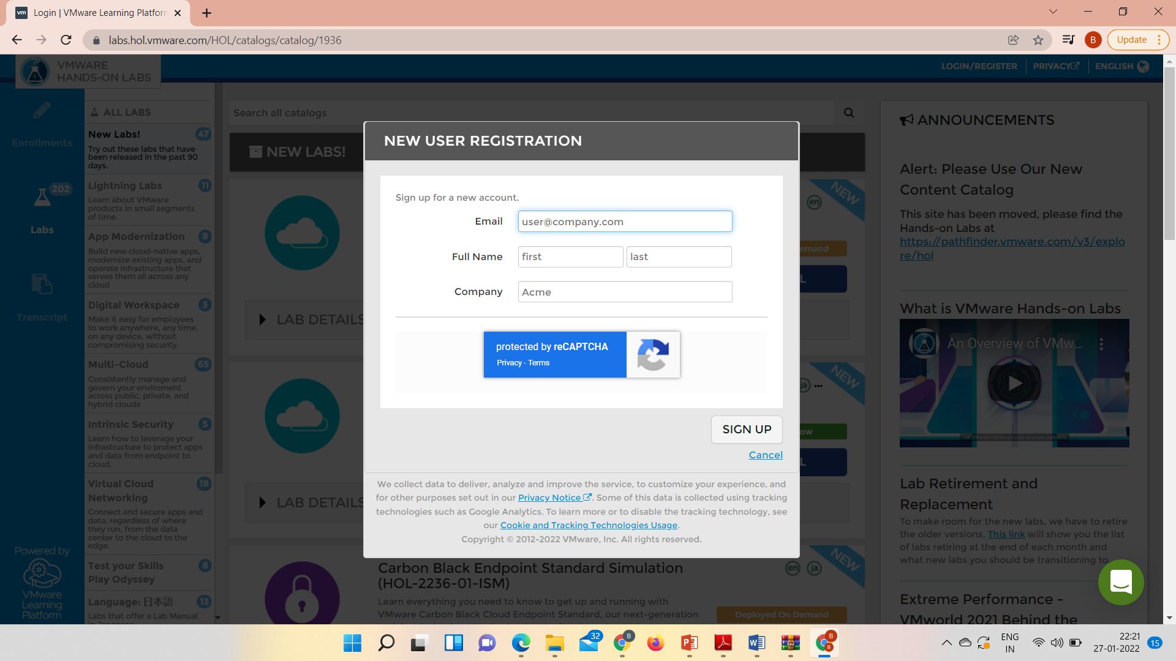
On clicking on register

Slide 14
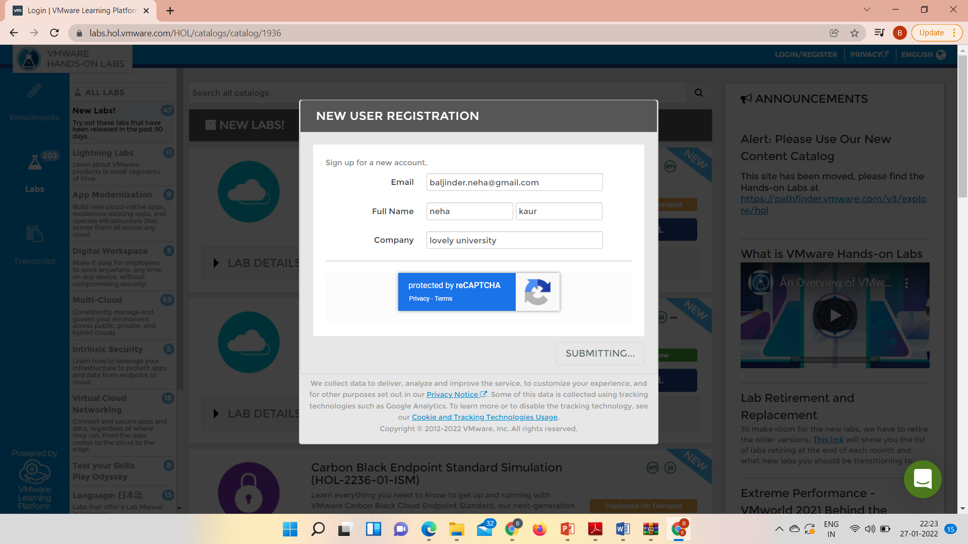

Slide 15
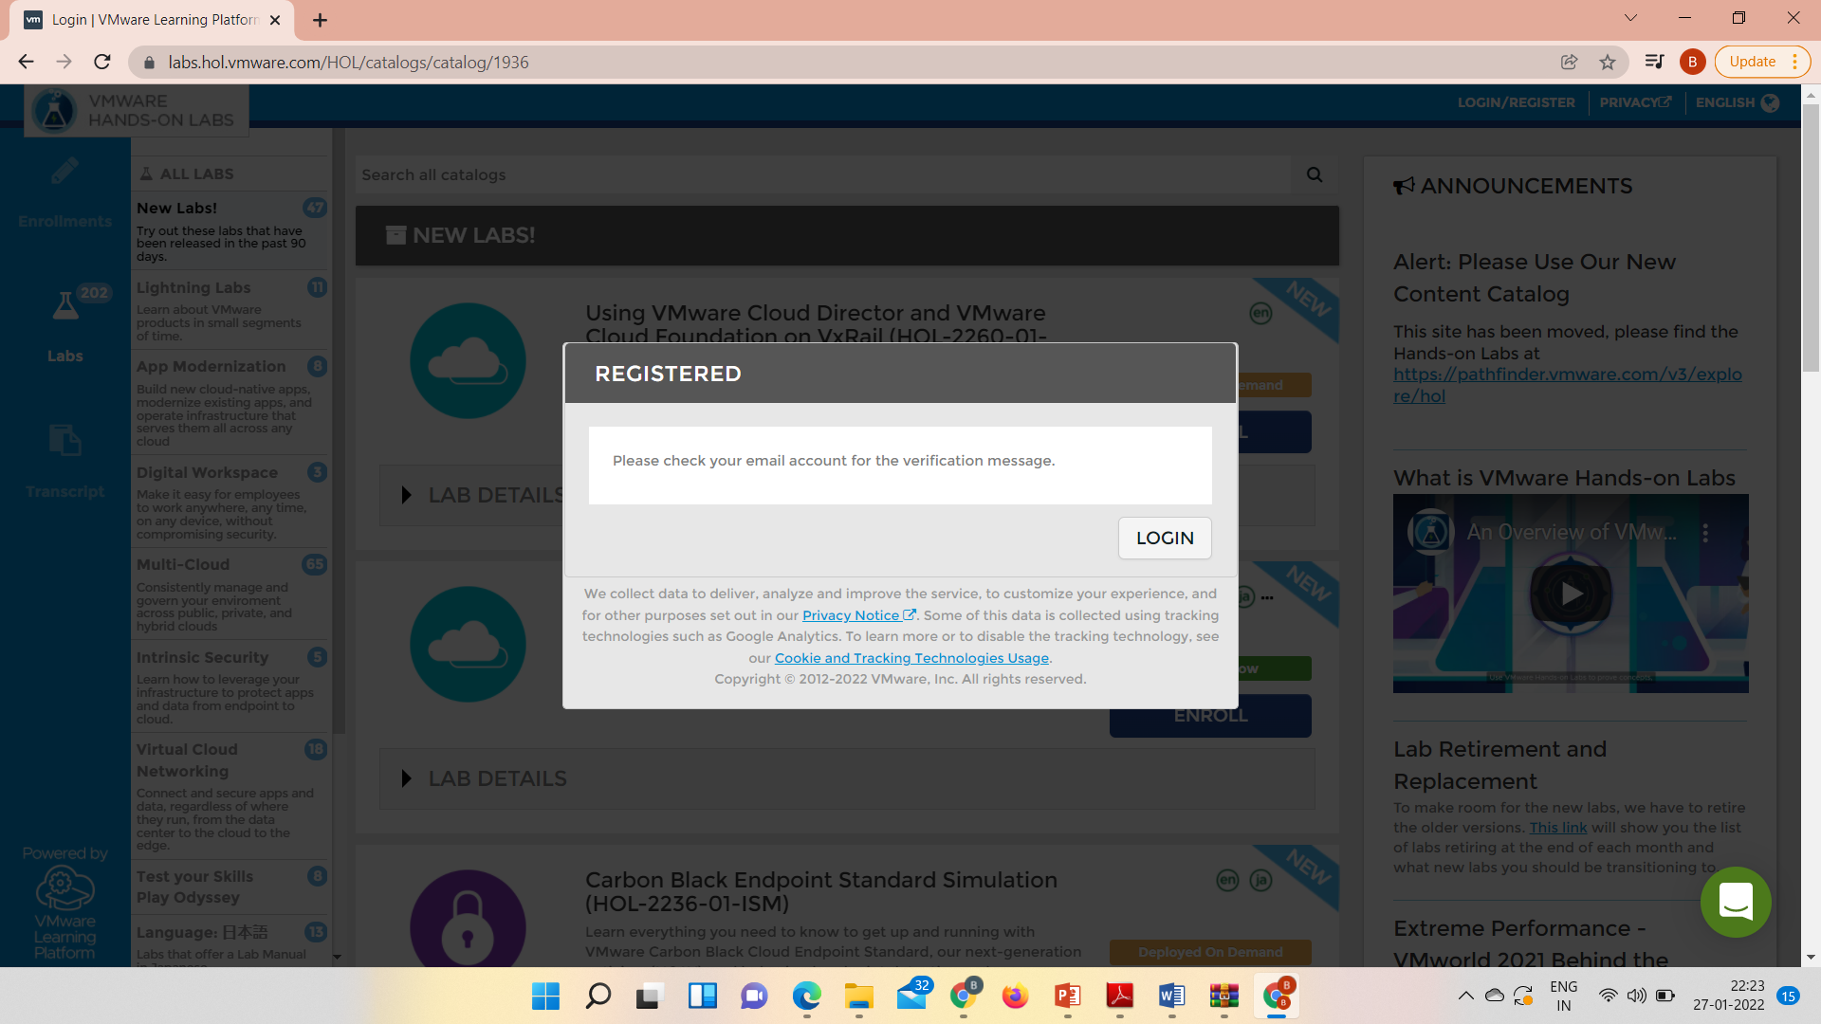

Slide 16
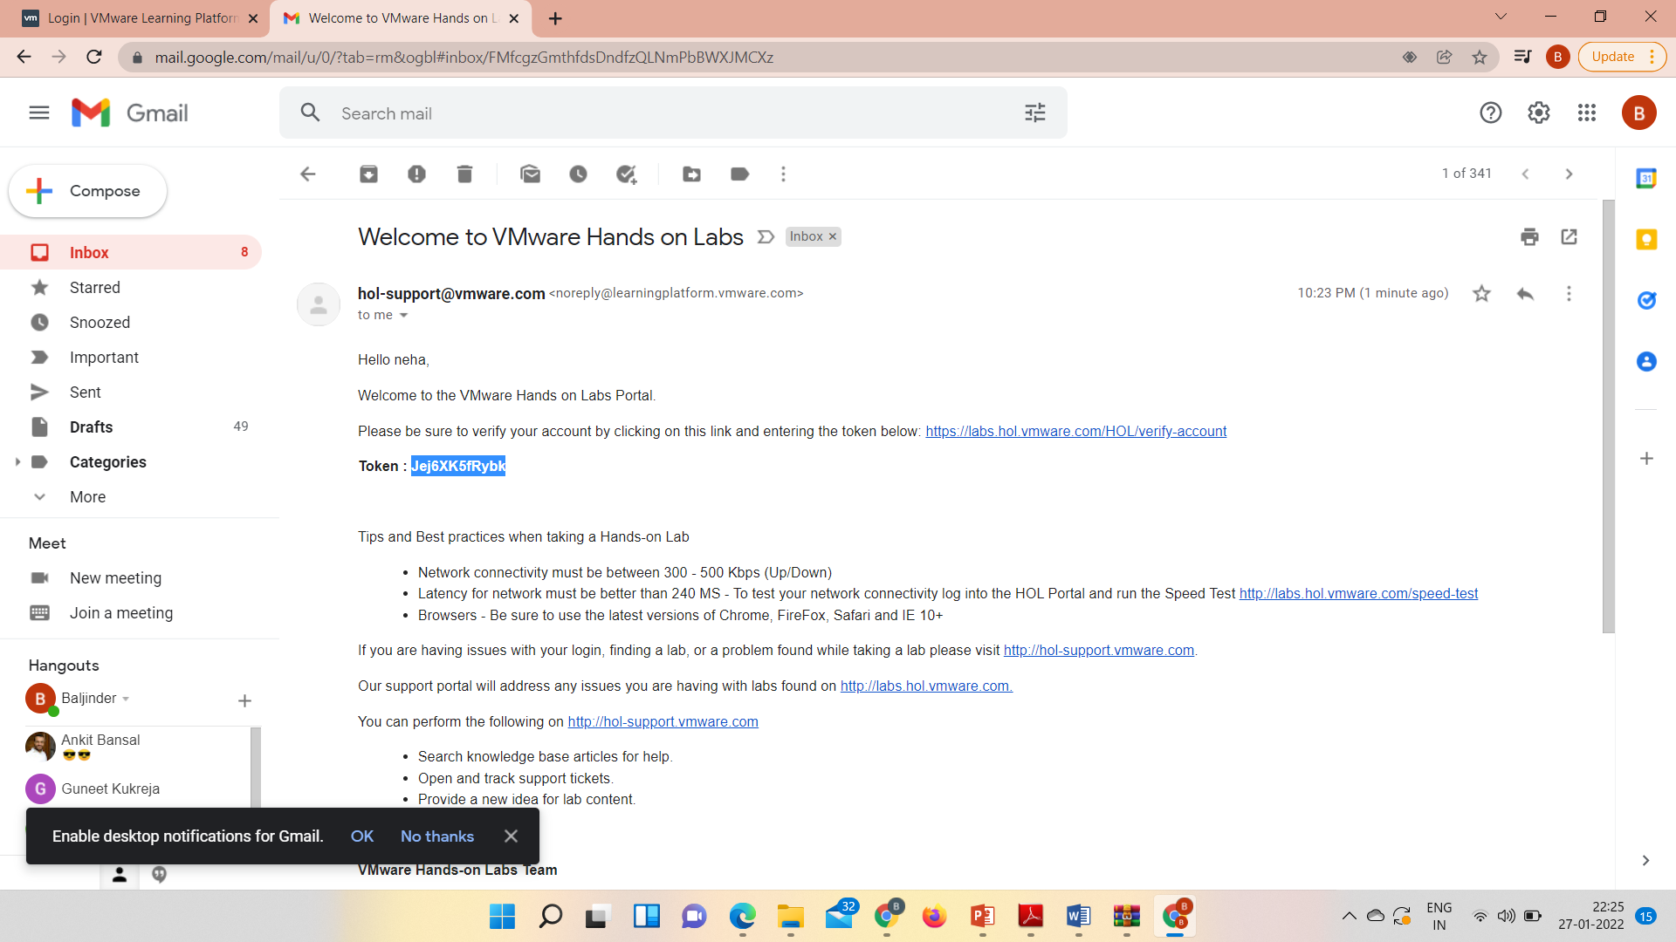

Slide 17
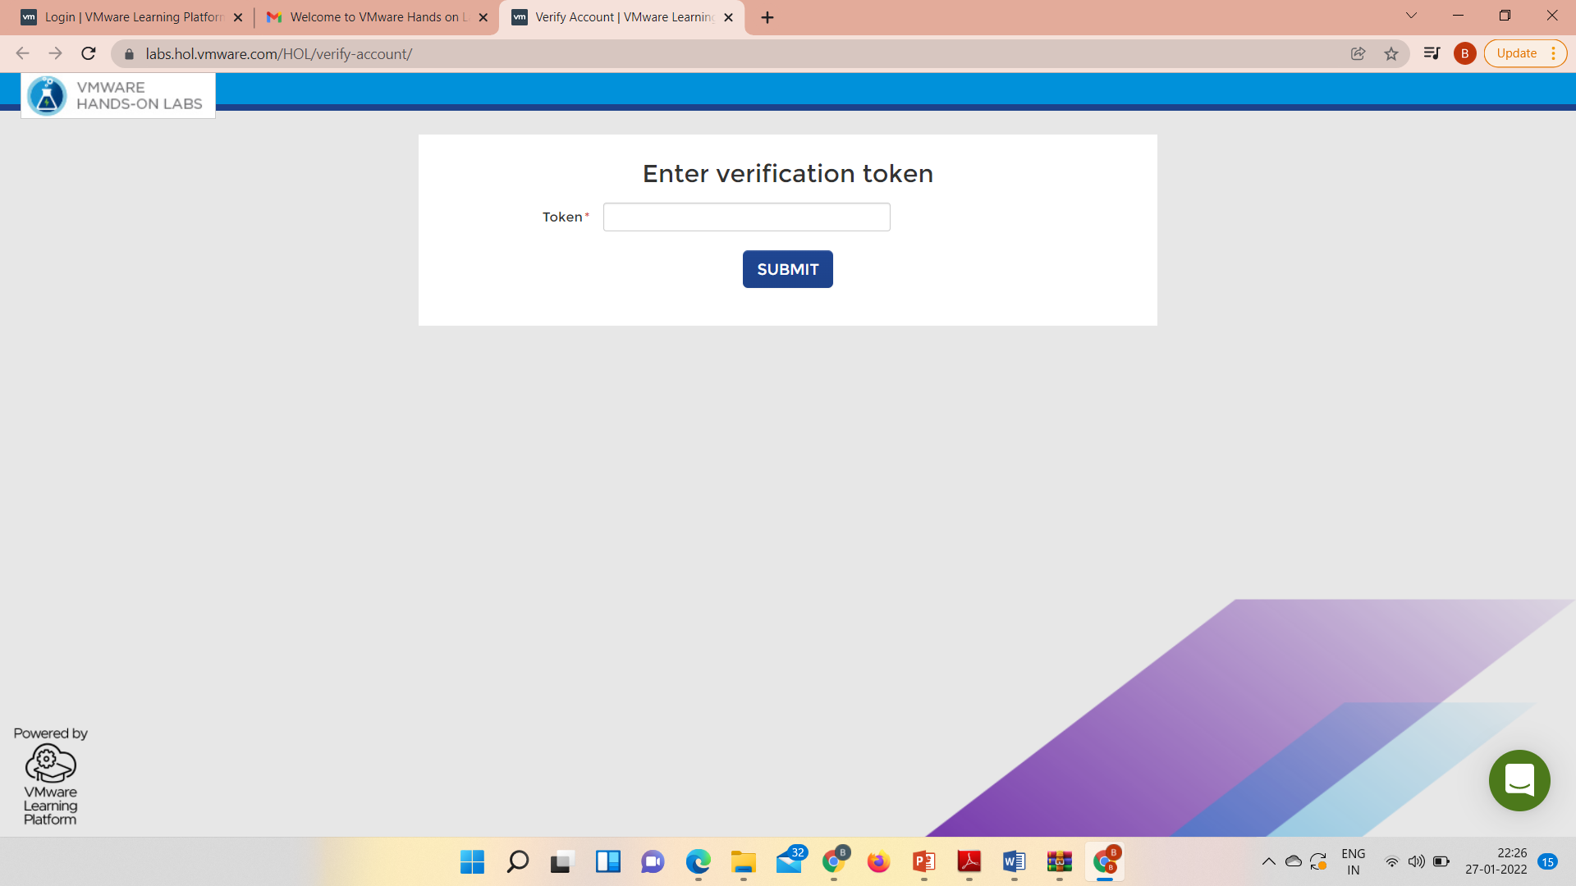

Slide 18


Slide 19
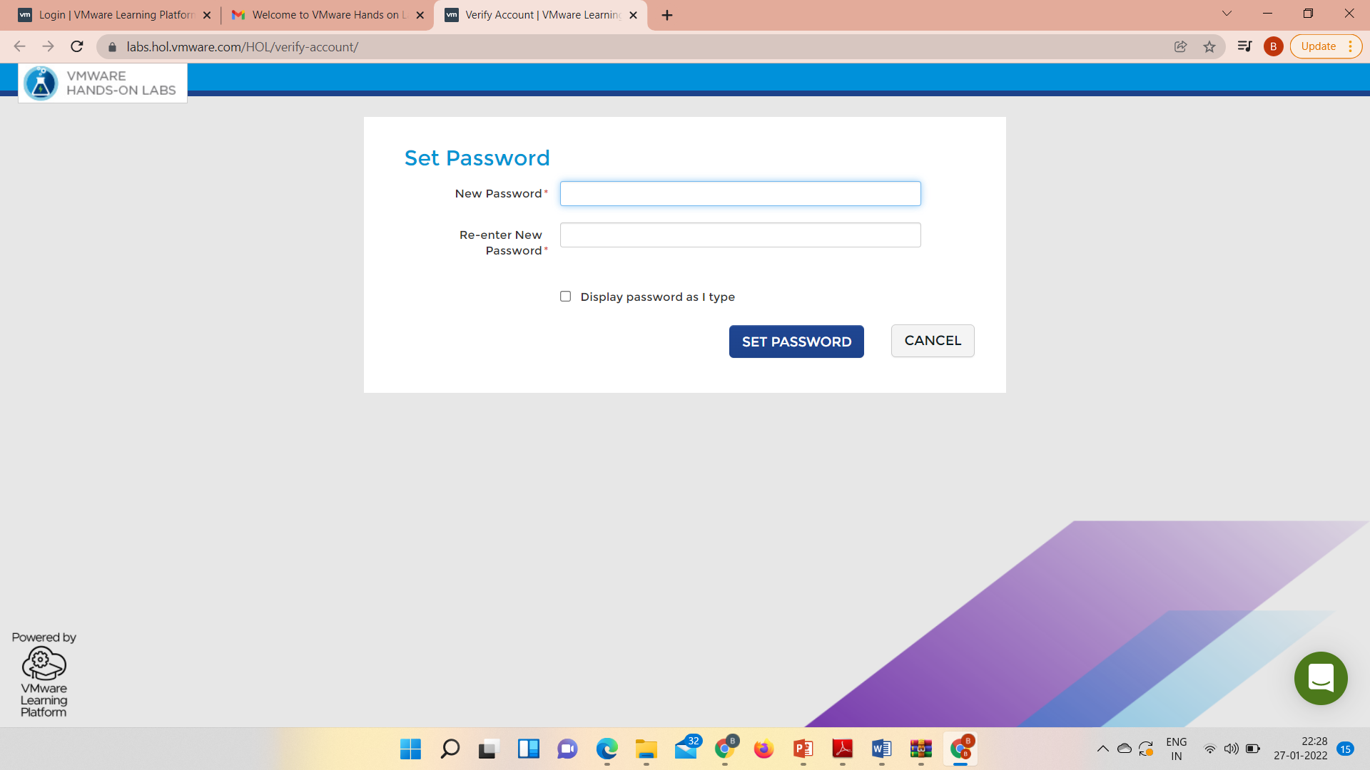

Slide 20


Slide 21
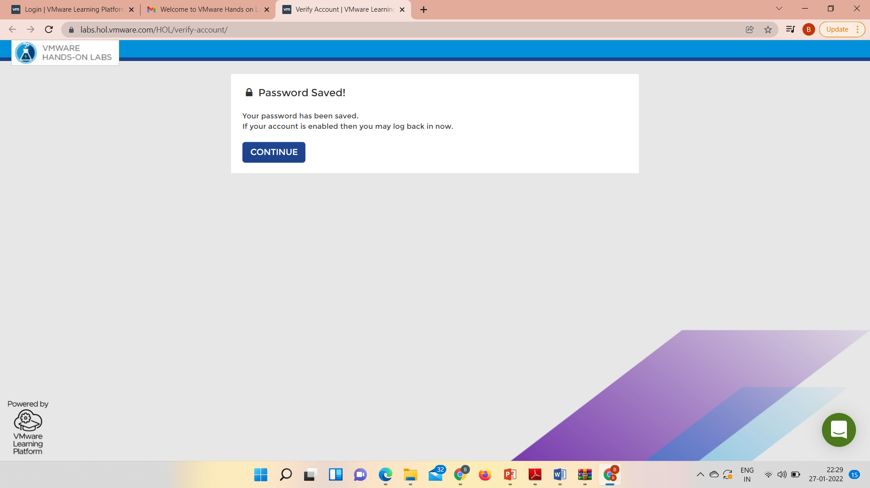

Slide 22
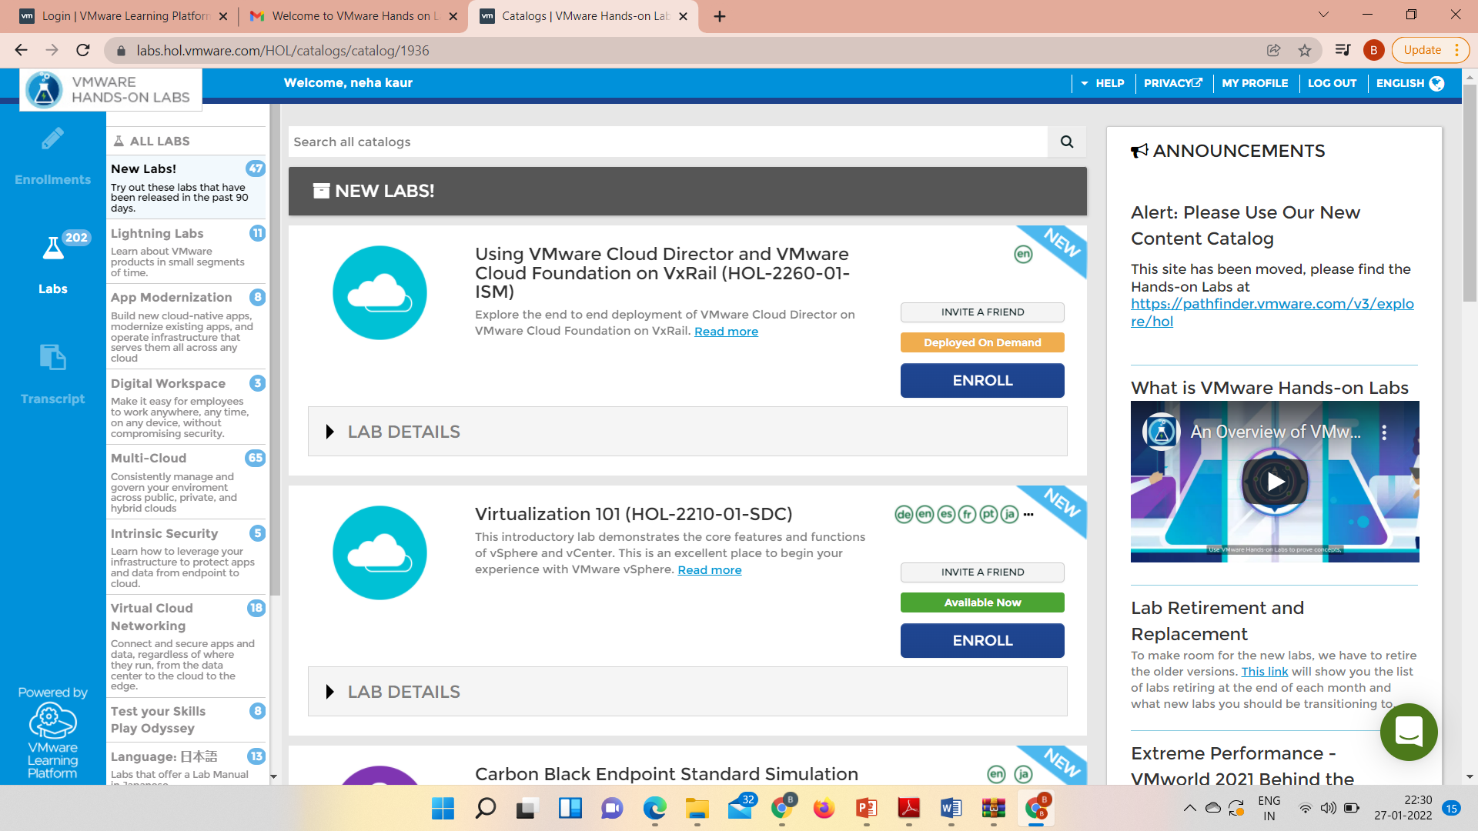

Slide 23
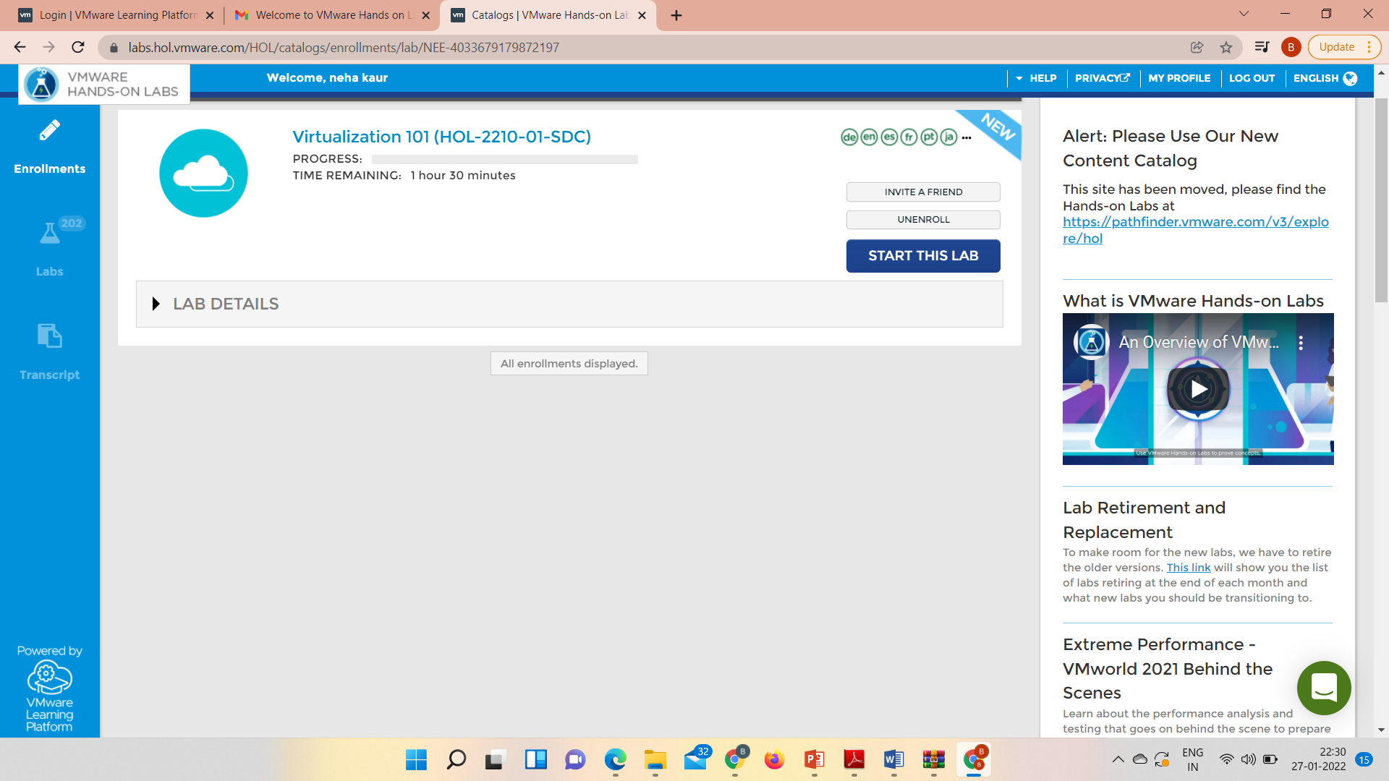

Slide 24
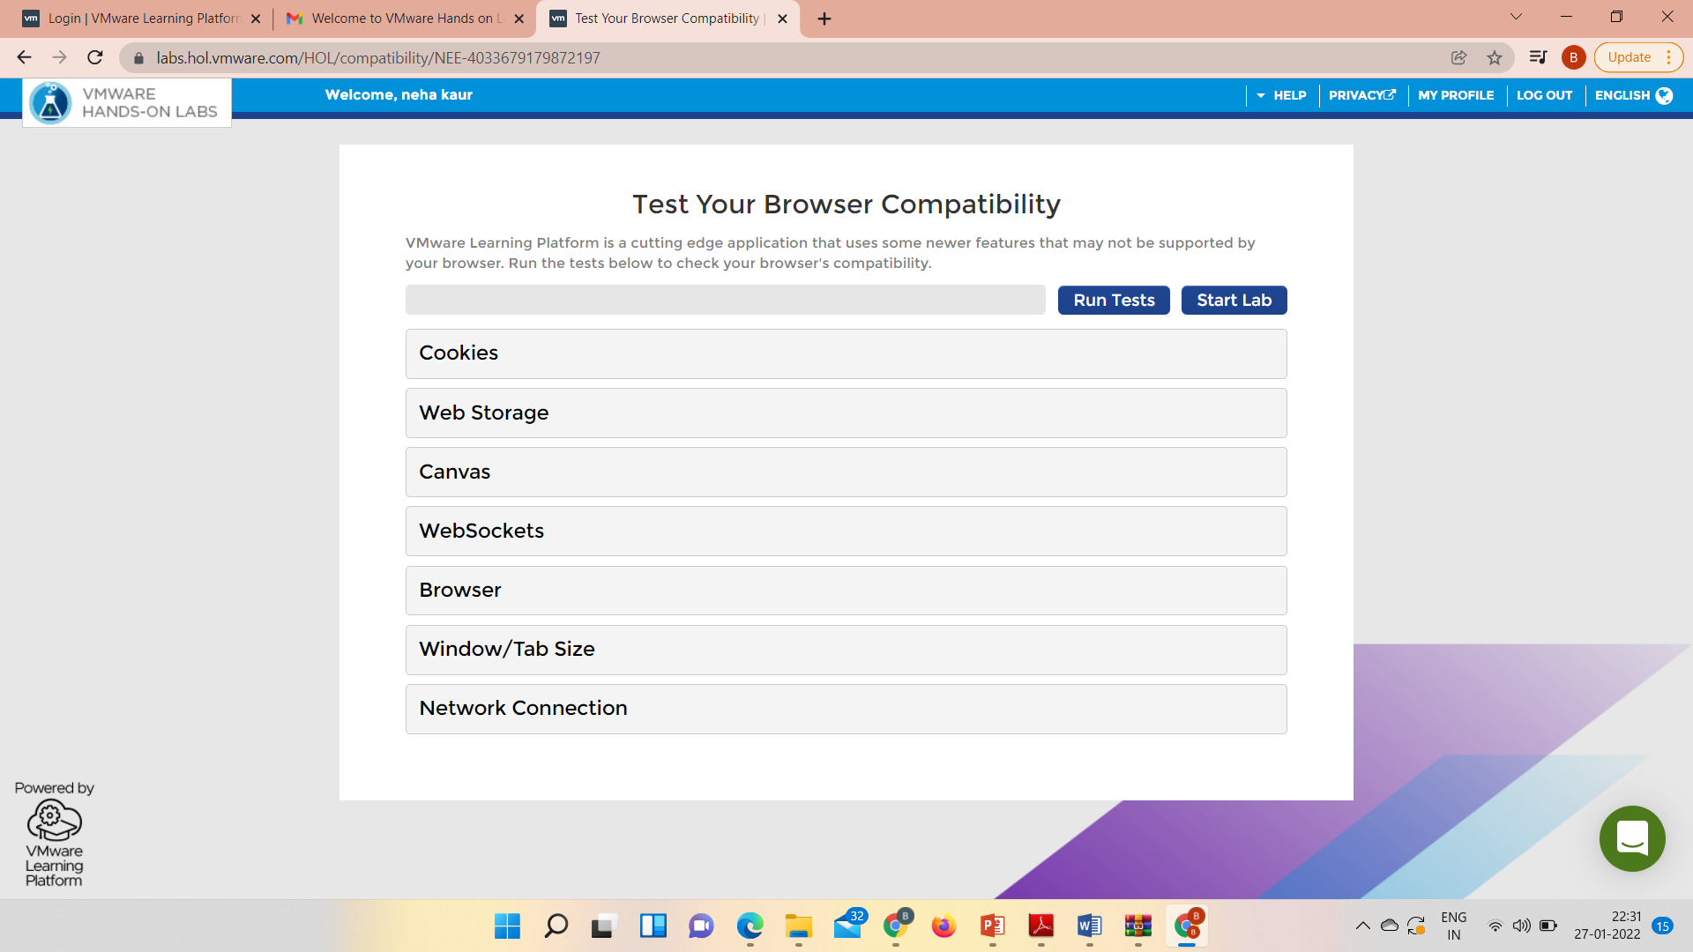

Slide 25
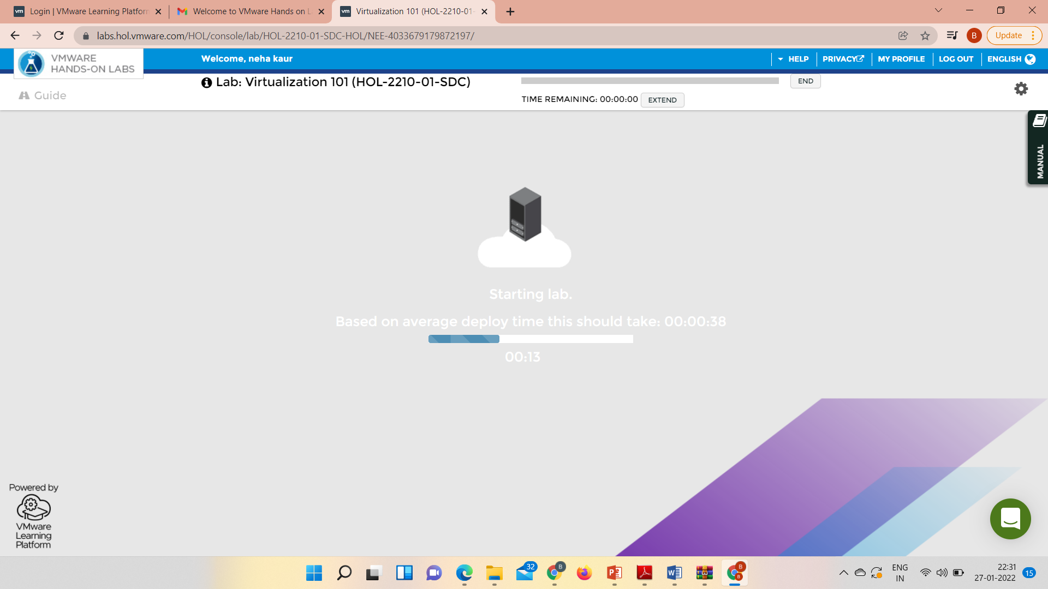

Slide 26
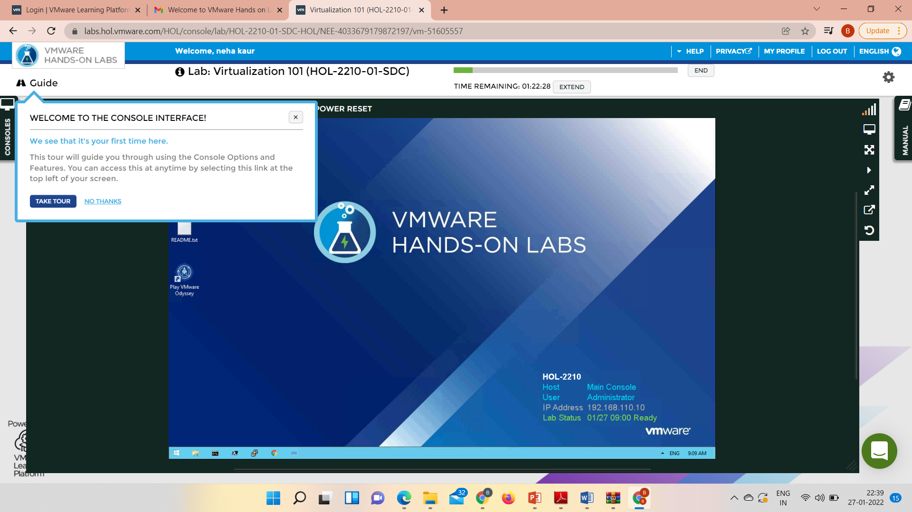

Slide 27
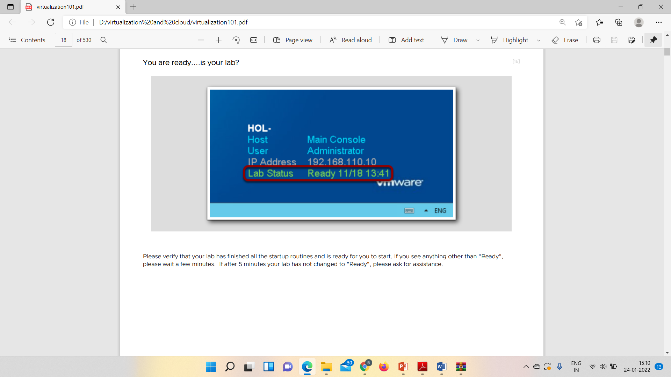

Slide 28
Open Chrome Browser

Slide 29
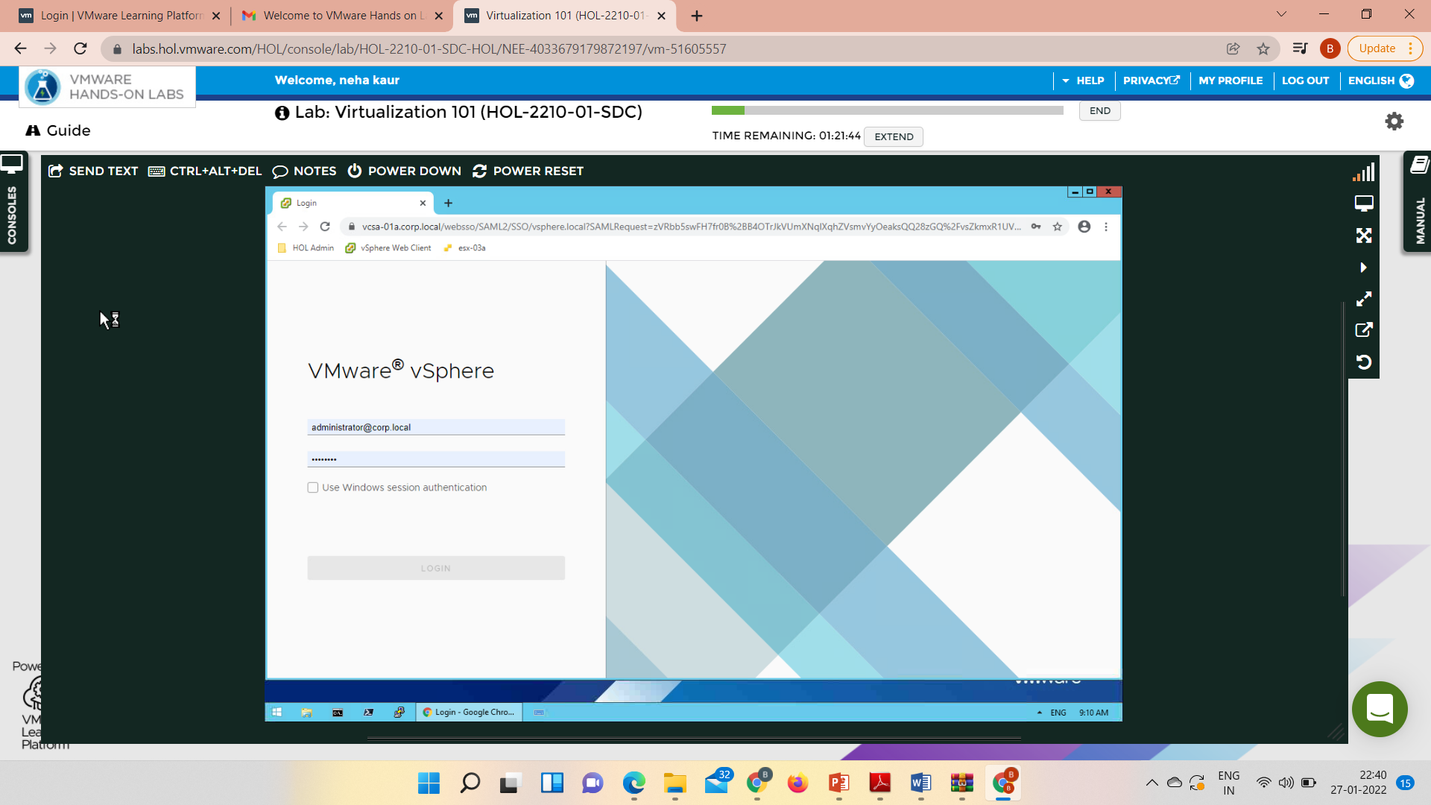

Slide 30
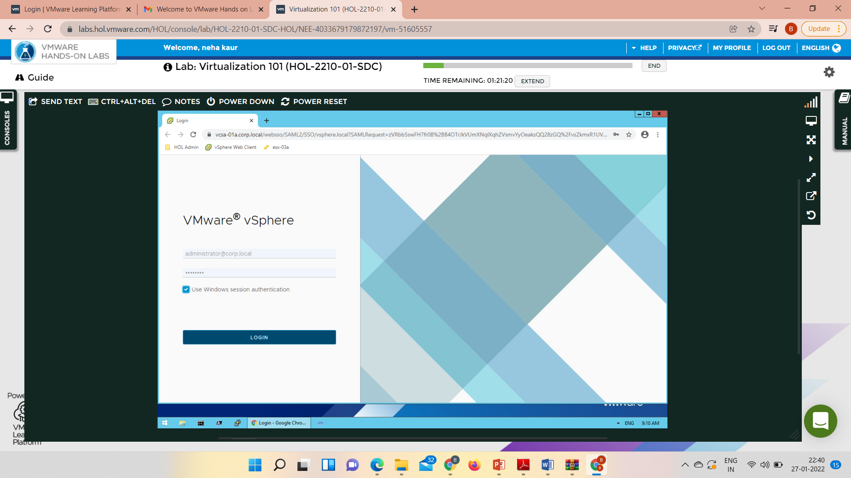

Slide 31
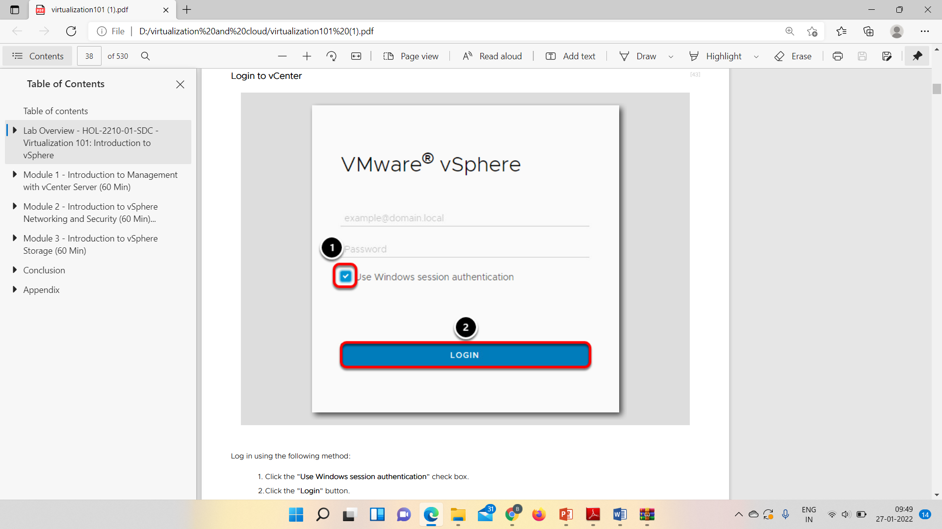

Slide 32
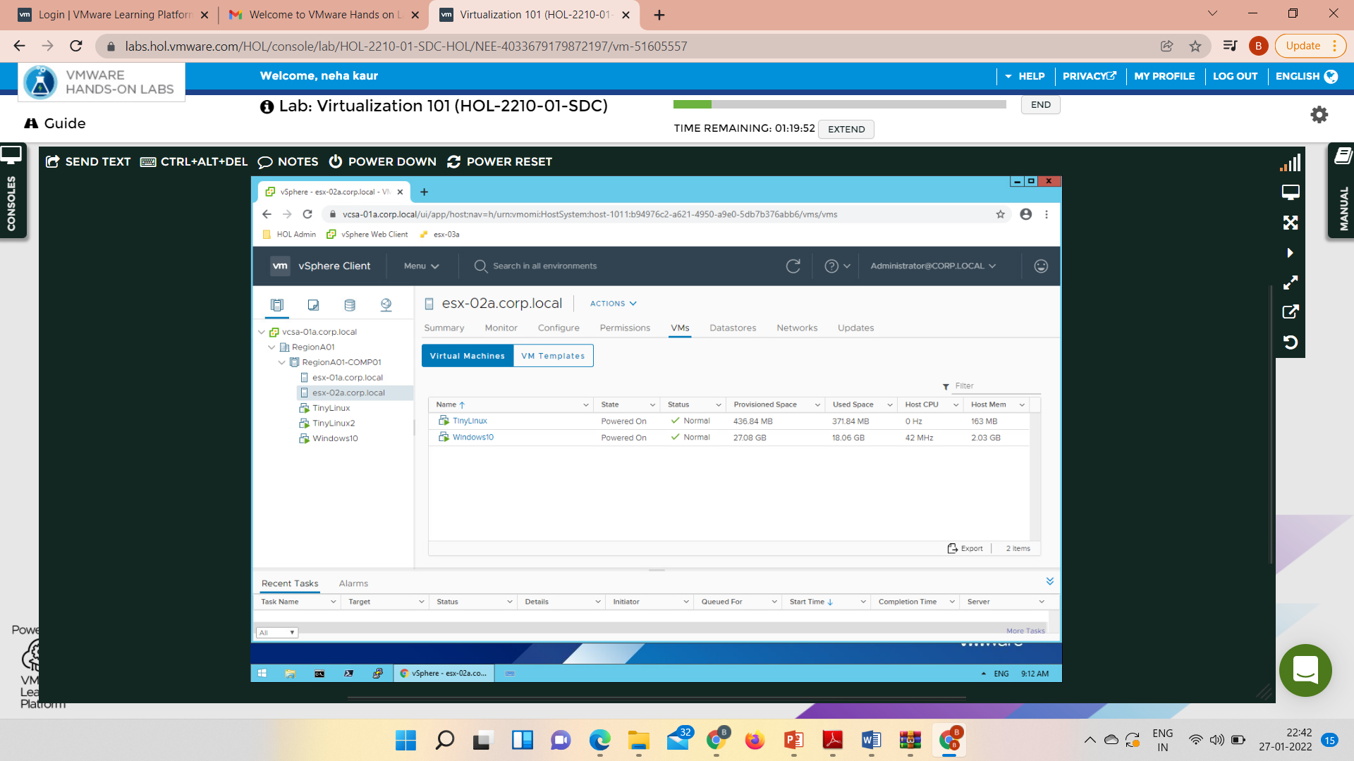

Slide 33
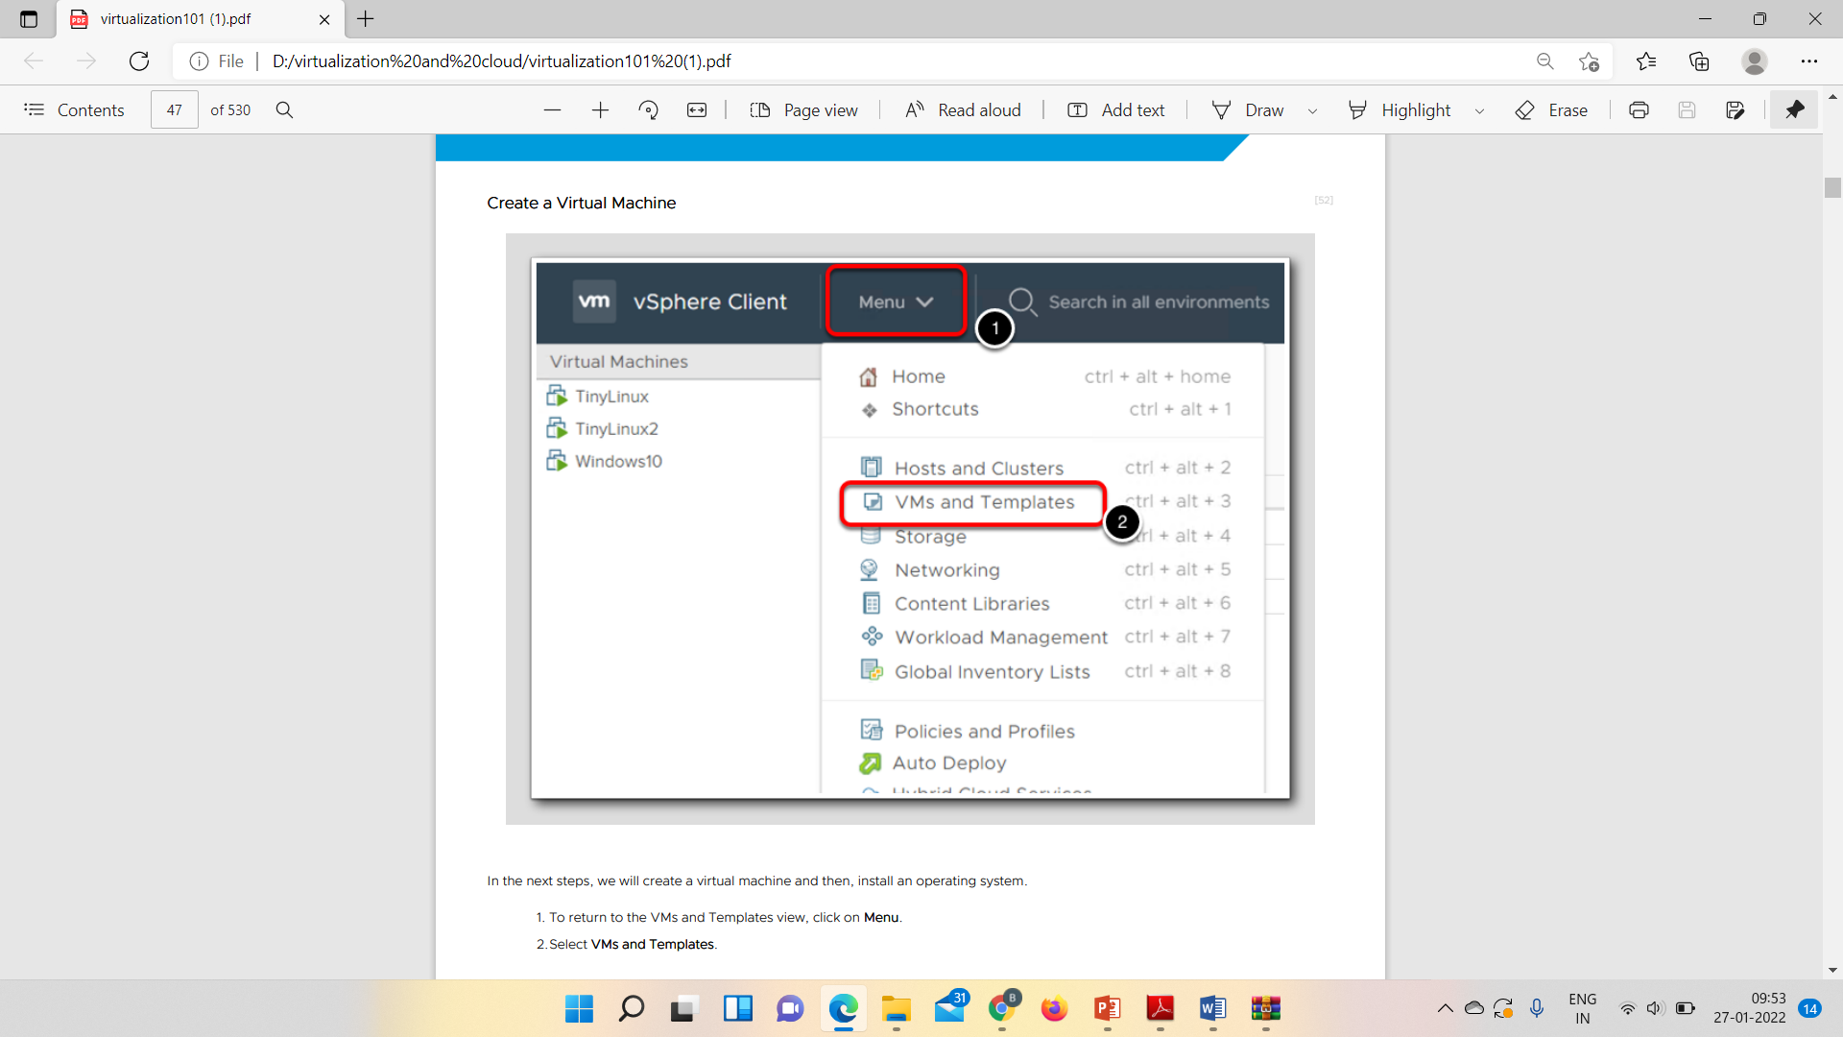

Slide 34
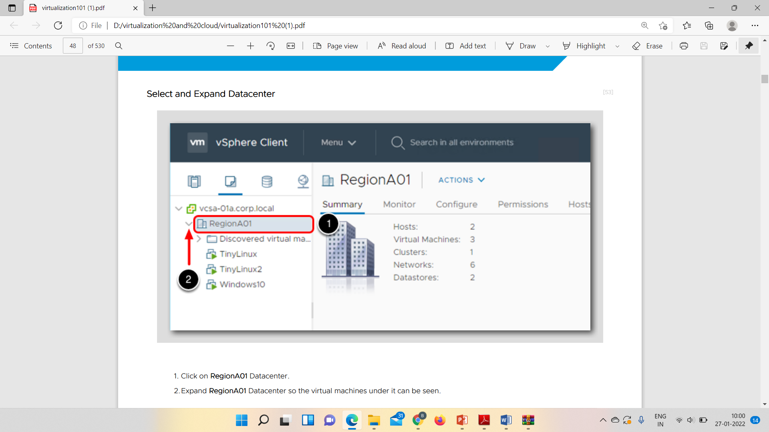

Slide 35
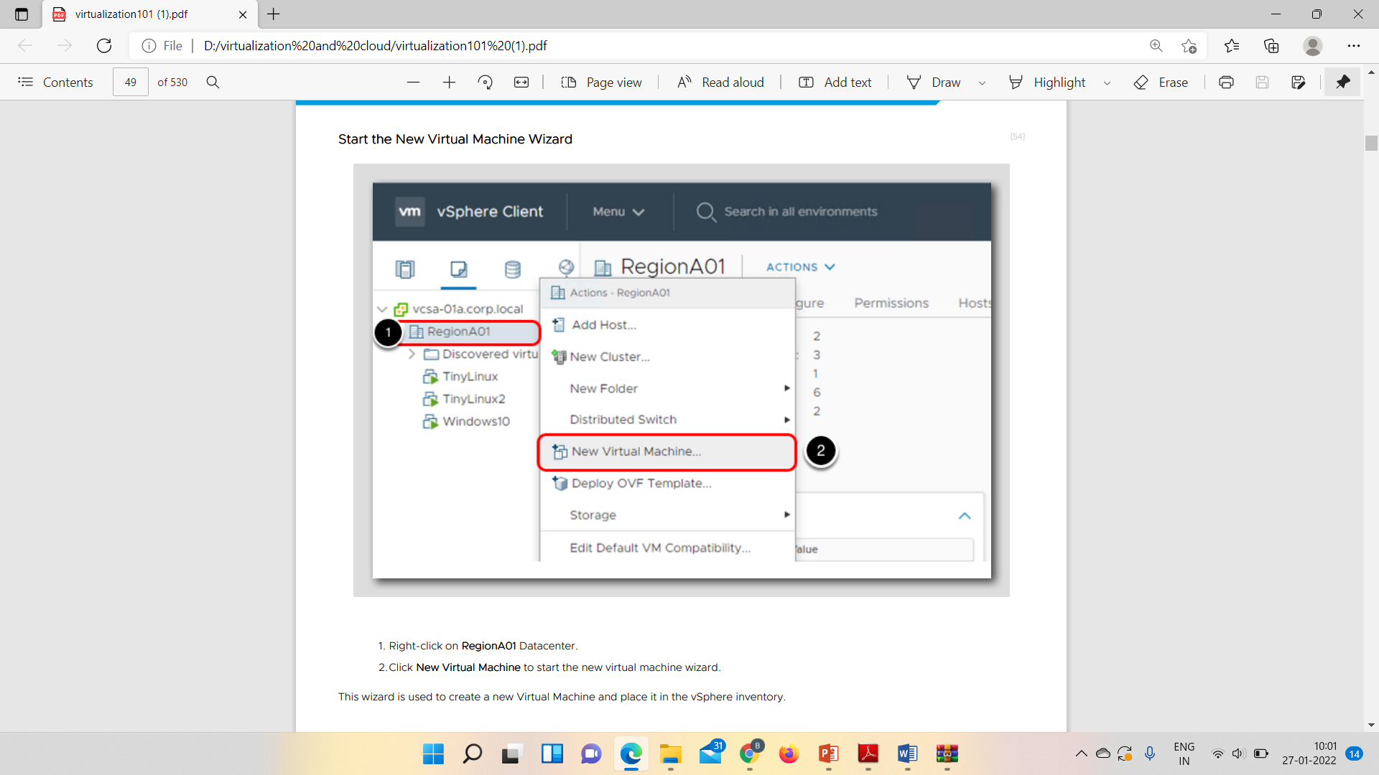
Right Click on RegionA01

Slide 36
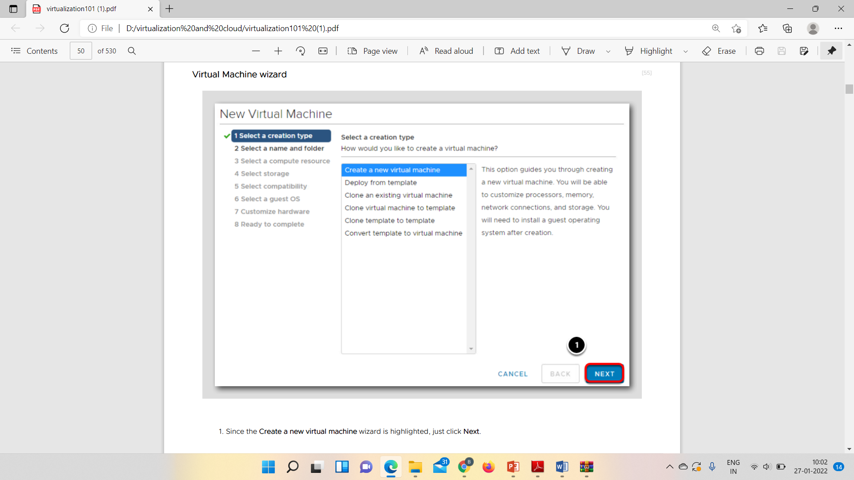
Press Tab from your Keyboard if Next button not shown

Slide 37
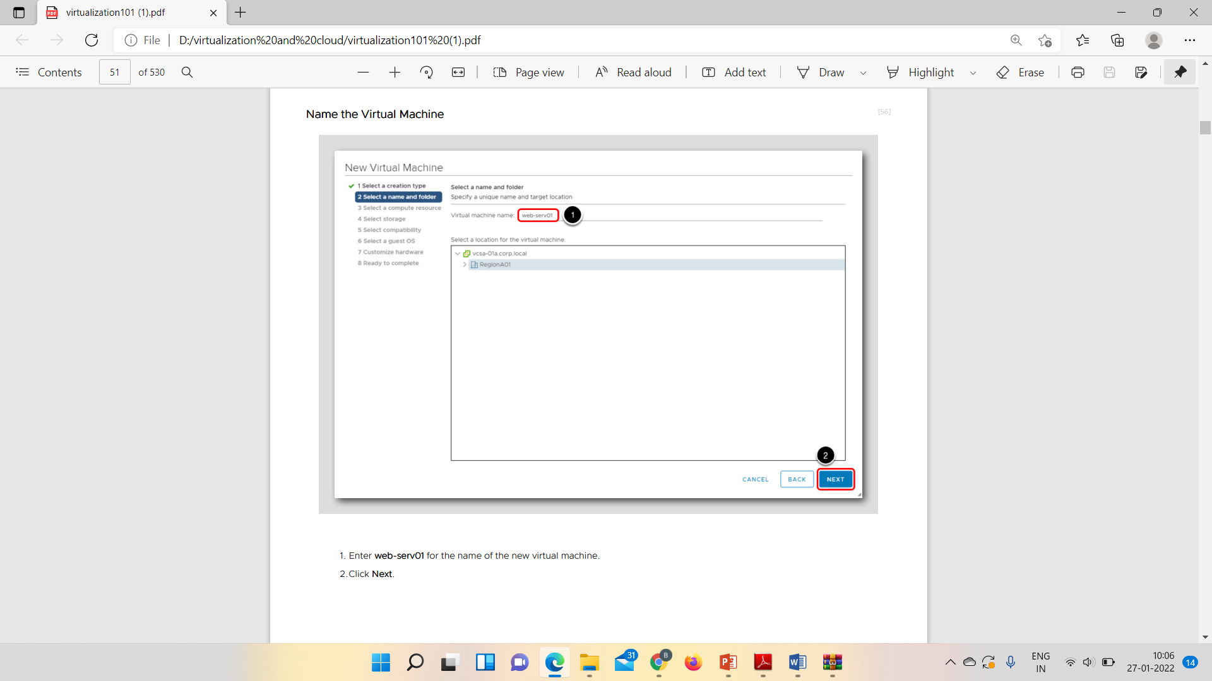
Enter Your Registration Number

Slide 38
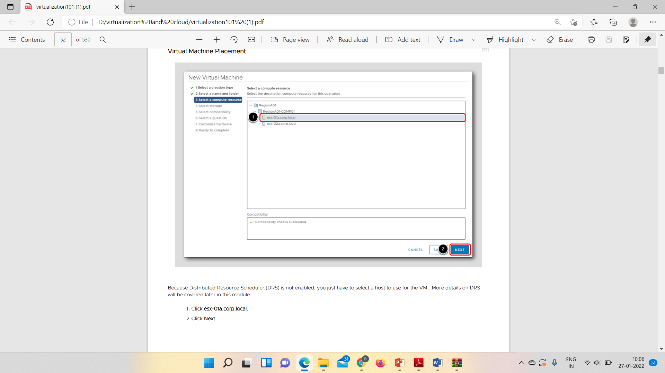

Slide 39
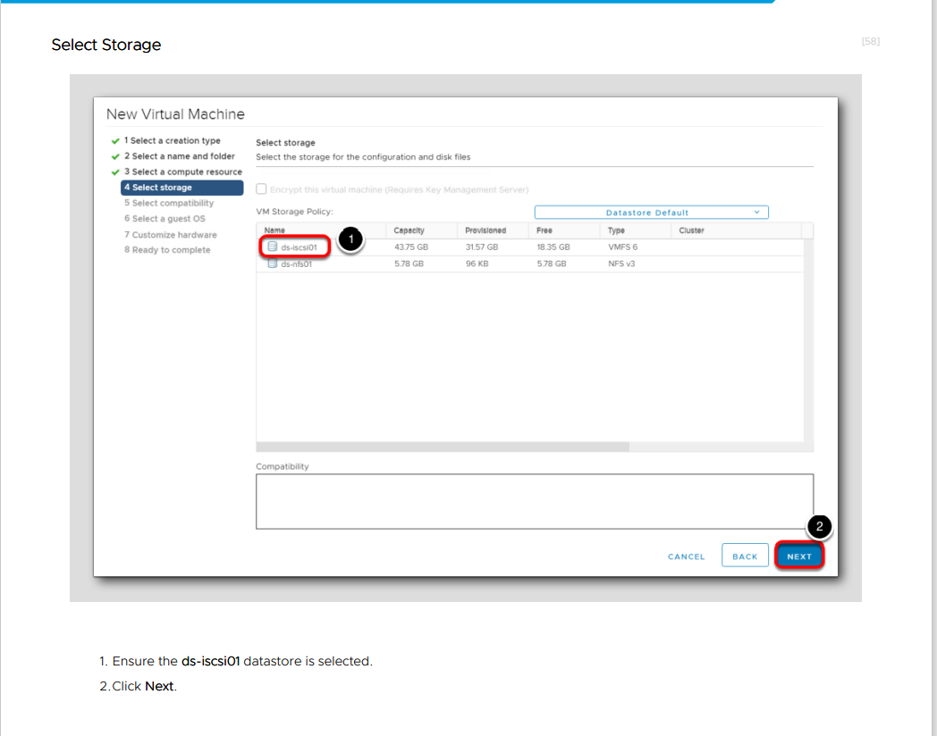

Slide 40
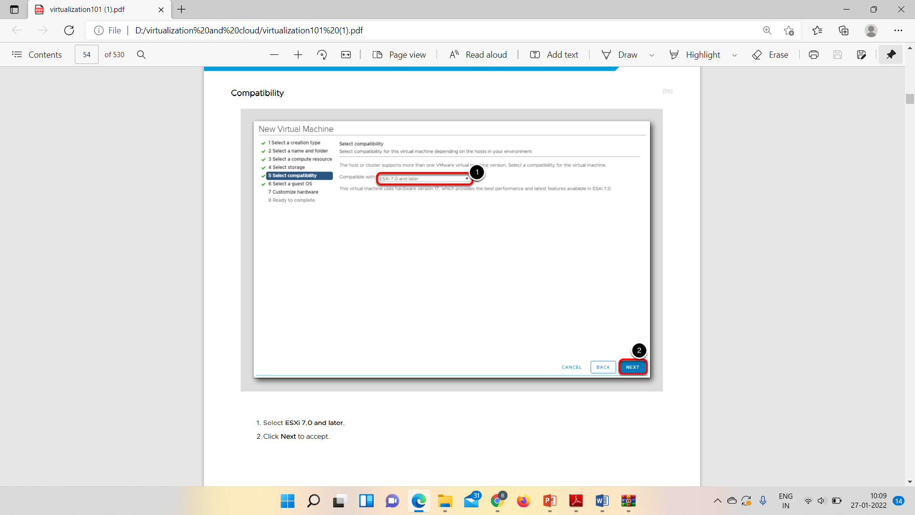

Slide 41
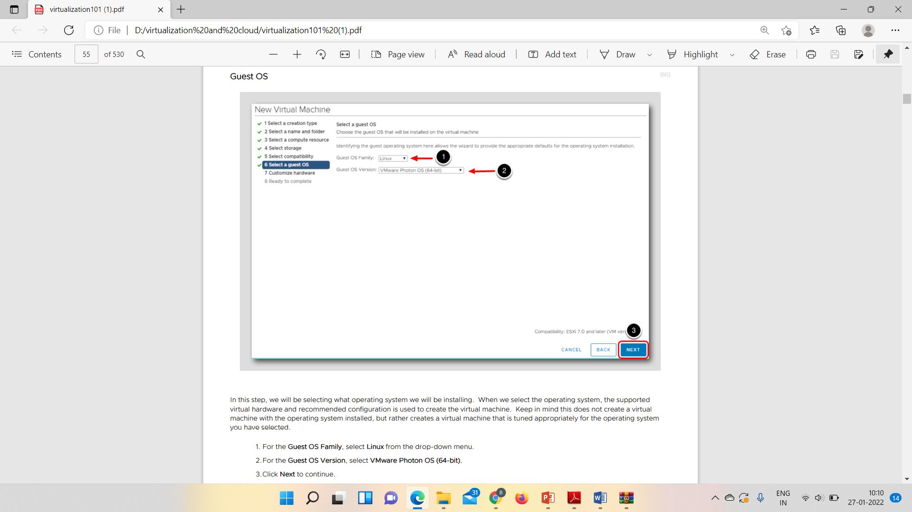

Slide 42
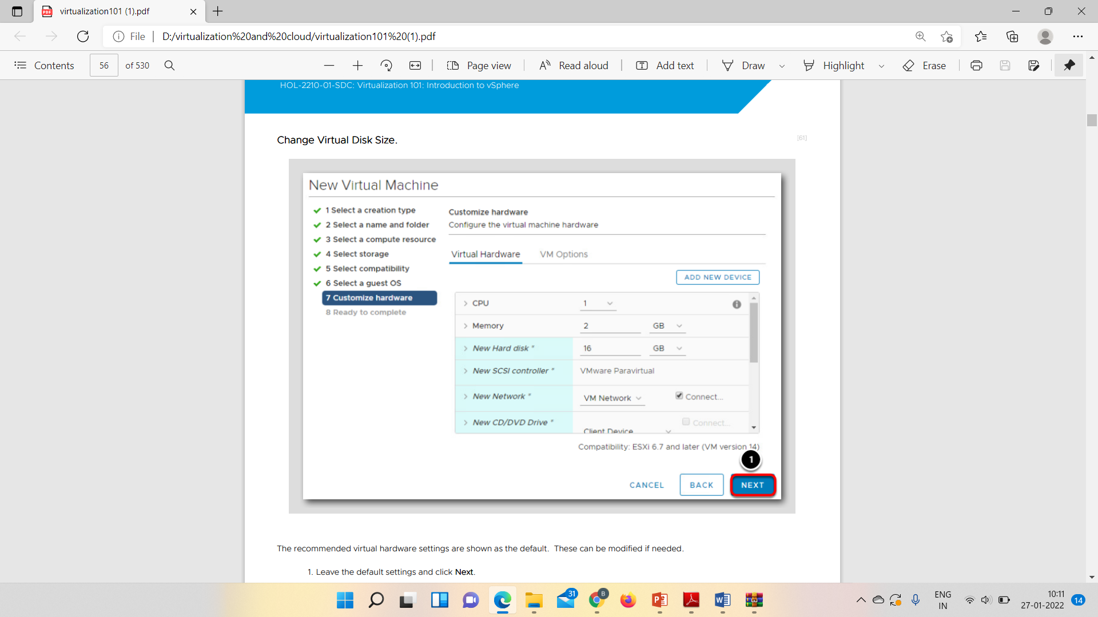

Slide 43
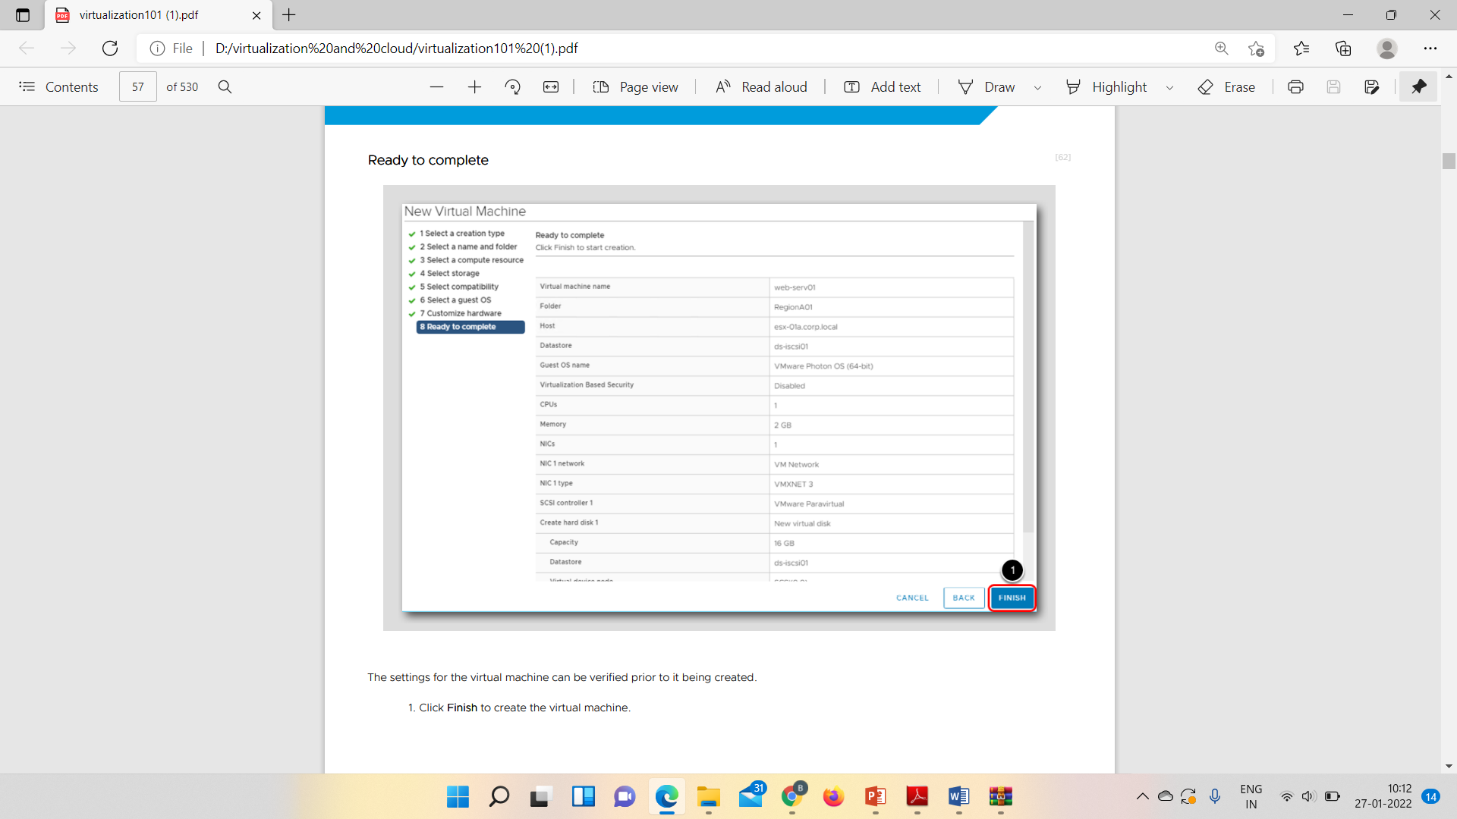

Slide 44
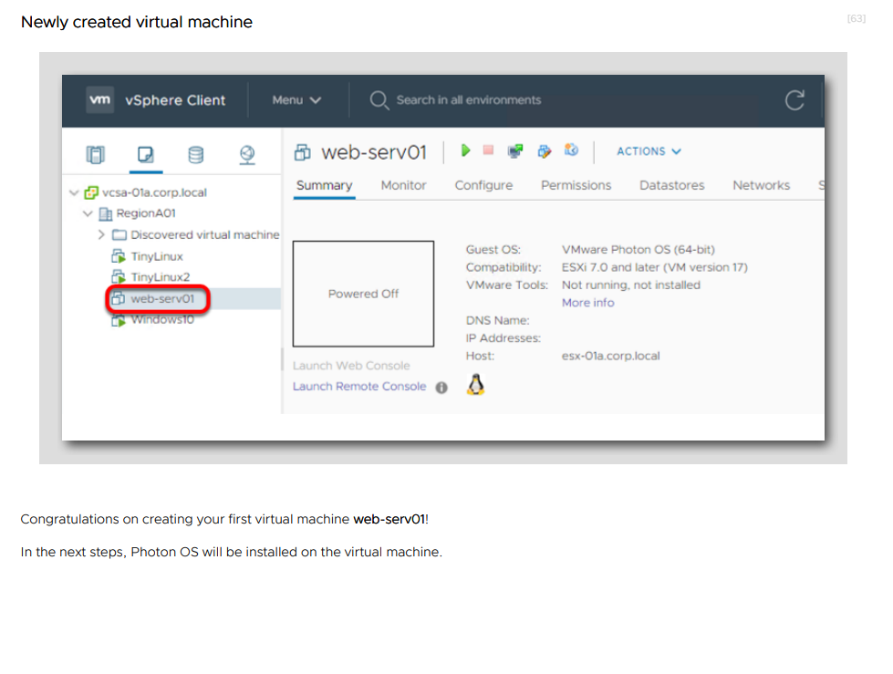

Slide 45
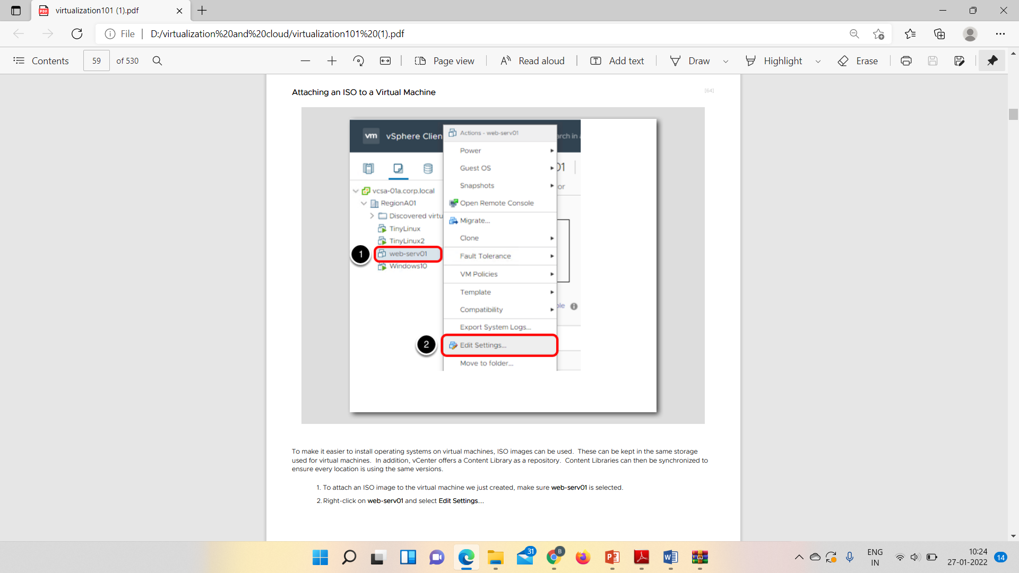

Slide 46
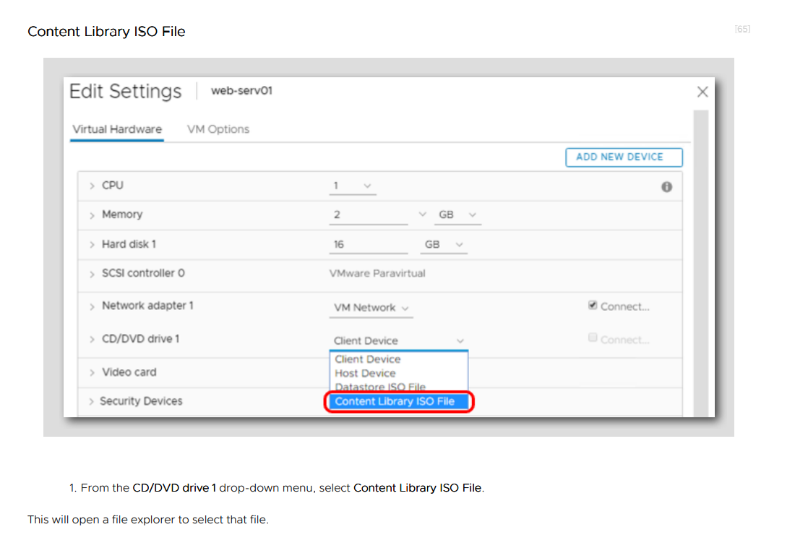

Slide 47
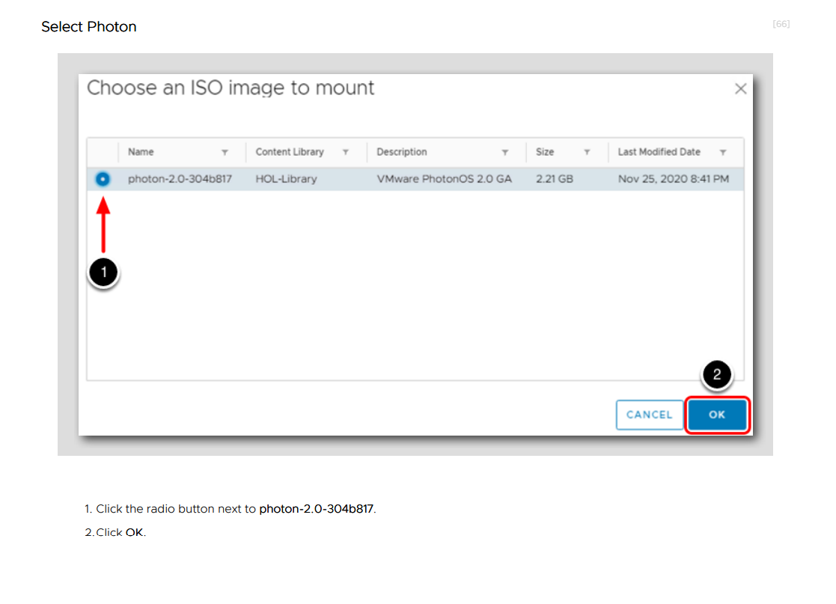

Slide 48
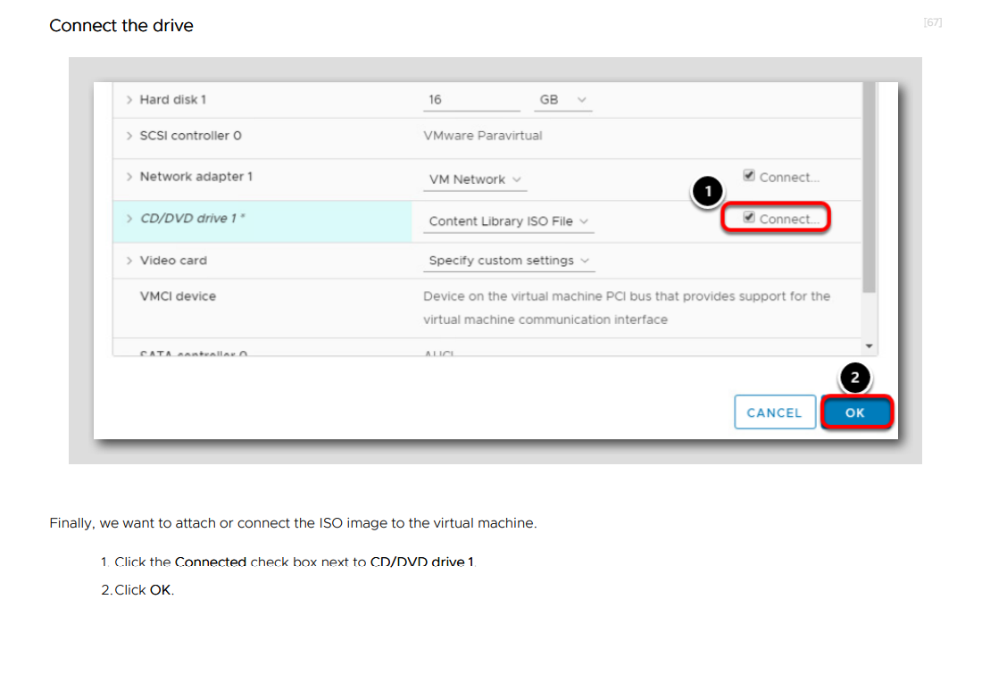

Slide 49
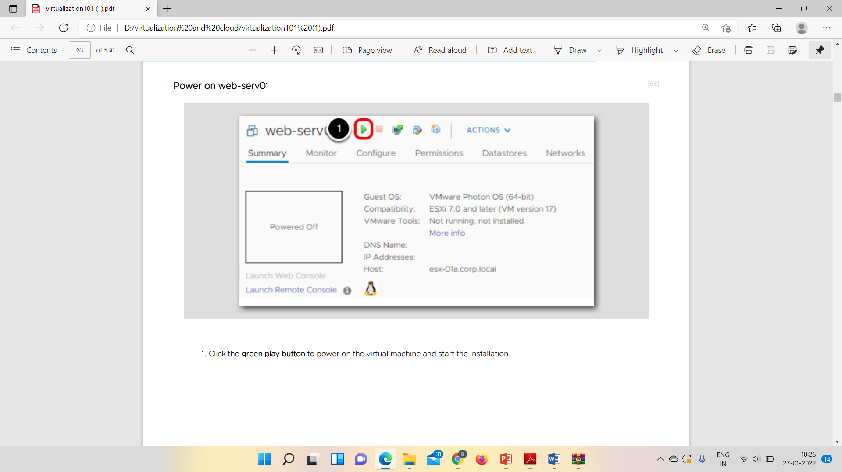

Slide 50
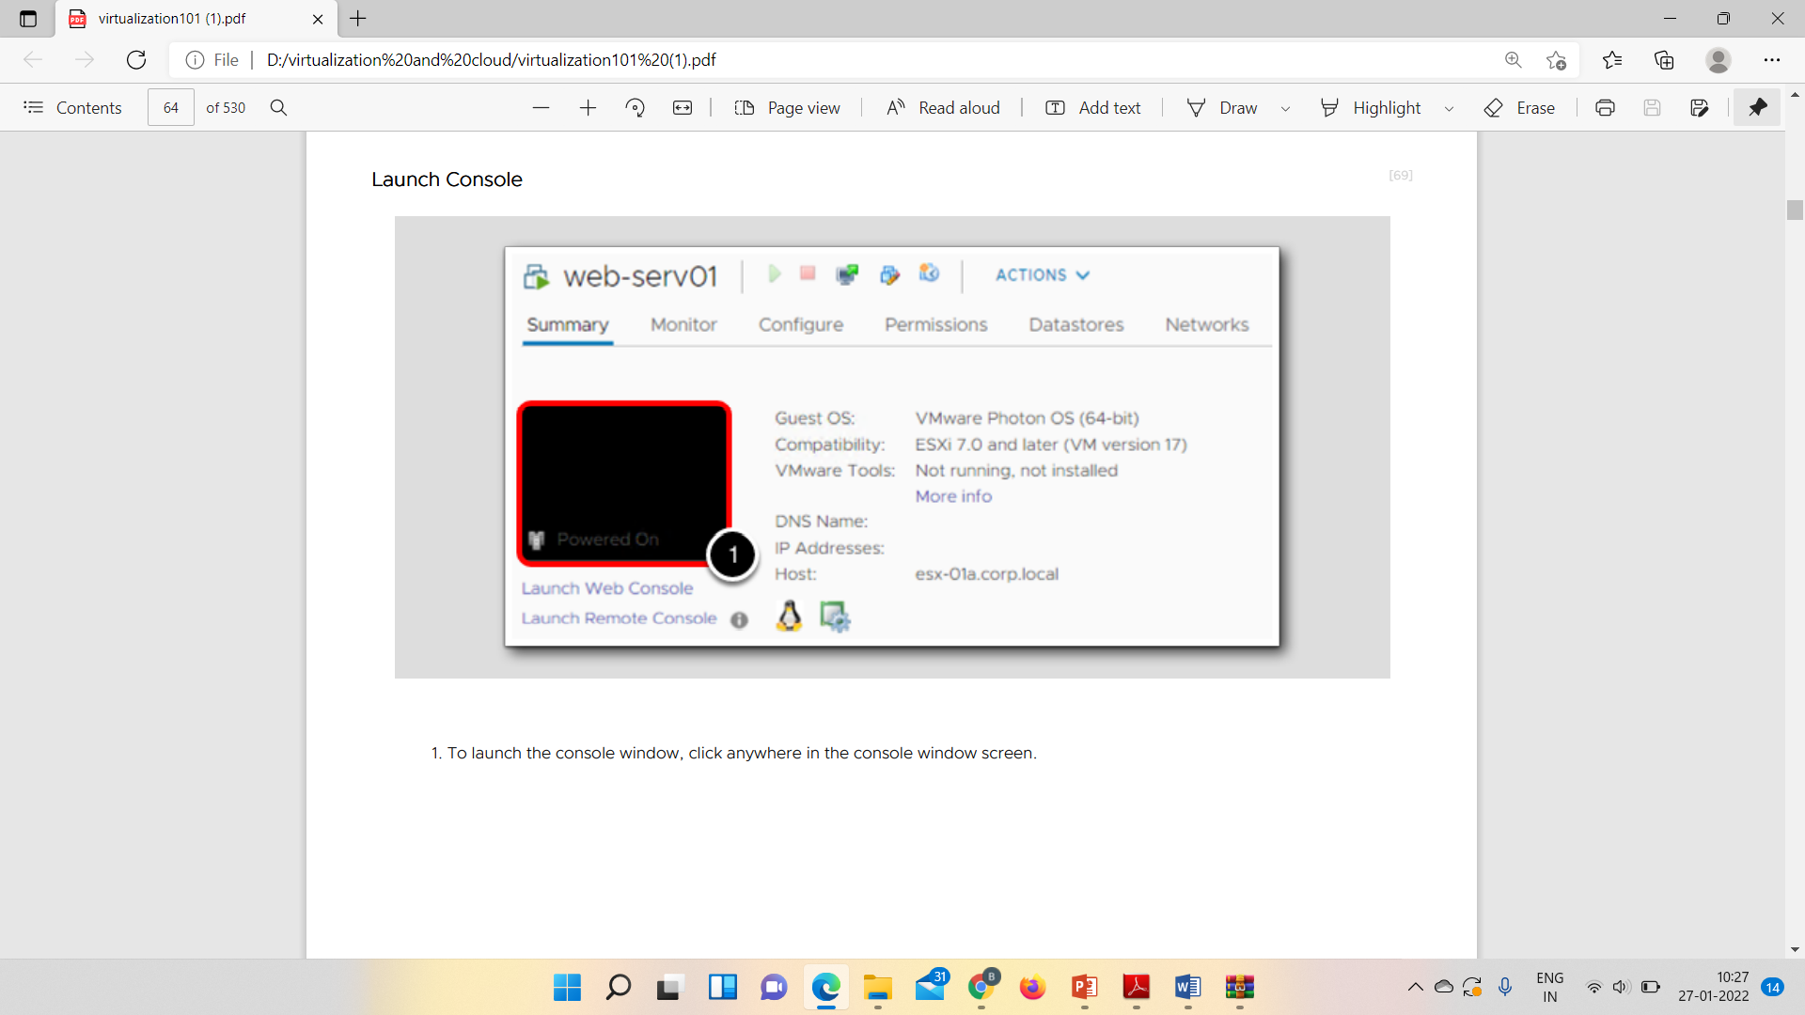

Slide 51
What is NFS?
NFS (Network File System) is a protocol that is used to serve and share files on a network. It provides file level access
What is iSCSI?
iSCSI is a transport layer protocol that describes how Small Computer System Interface (SCSI) packets are transferred over a network. It works by transporting data between a server and a storage device.
Notes:
A network file system (NFS) is a type of file system mechanism that enables the storage and retrieval of data from multiple disks and directories across a shared network. A network file system enables local users to access remote data and files in the same way they are accessed locally.

Slide 52
What is different about NFS and iSCSI?
NFS and iSCSI are fundamentally different ways of data sharing. NFS is built for data sharing among multiple client machines. On the opposite end, iSCSI is a block protocol which supports a single client for each volume on the server. While it does permit applications running on a single client machine to share remote data, it is not the best for sharing data across machines. It is possible to run iSCSI in a shared multi-client environment but requires designing a distributed file system that accesses data from a block server.

Slide 53
Block storage, sometimes referred to as block-level storage, is a technology that is used to store data files on Storage Area Networks (SANs) or cloud-based storage environments. Developers favor block storage for computing situations where they require fast, efficient, and reliable data transportation.
Block storage breaks up data into blocks and then stores those blocks as separate pieces, each with a unique identifier. The SAN places those blocks of data wherever it is most efficient.
This creates multiple paths to the data and allows the user to retrieve it quickly. When a user or application requests data from a block storage system, the underlying storage system reassembles the data blocks and presents the data to the user or application.
Notes:
That means it can store those blocks across different systems and each block can be configured (or partitioned) to work with different operating systems.
Block storage also decouples data from user environments, allowing that data to be spread across multiple environments.

